Slide 1
CS162 Operating Systems and Systems Programming Lecture 9 Synchronization, Readers/Writers example, Scheduling
February 14th, 2018
Profs. Anthony D. Joseph and Jonathan Ragan-Kelley
http://cs162.eecs.Berkeley.edu

Slide 2
Complete Monitor Example (with cond. variable)
Here is an (infinite) synchronized queue
Lock lock; Condition dataready; Queue queue;
AddToQueue(item) { lock.Acquire(); // Get Lock queue.enqueue(item); // Add item dataready.signal(); // Signal any waiters lock.Release(); // Release Lock }
RemoveFromQueue() { lock.Acquire(); // Get Lock while (queue.isEmpty()) { dataready.wait(&lock); // If nothing, sleep } item = queue.dequeue(); // Get next item lock.Release(); // Release Lock return(item); }

Slide 3
Mesa vs. Hoare monitors
Need to be careful about precise definition of signal and wait. Consider a piece of our dequeue code:
while (queue.isEmpty()) { dataready.wait(&lock); // If nothing, sleep } item = queue.dequeue(); // Get next item
Why didn’t we do this?
if (queue.isEmpty()) { dataready.wait(&lock); // If nothing, sleep } item = queue.dequeue(); // Get next item
Answer: depends on the type of scheduling
Hoare-style
Mesa-style

Slide 4
Hoare monitors
Signaler gives up lock, CPU to waiter; waiter runs immediately
Waiter gives up lock, processor back to signaler when it exits critical section or if it waits again
Most textbooks
…
lock.Acquire()
…
dataready.signal();
…
lock.Release();
lock.Acquire()
…
if (queue.isEmpty()) { dataready.wait(&lock); } …
lock.Release();
Lock, CPU
Lock, CPU

Slide 5
Mesa monitors
Signaler keeps lock and processor
Waiter placed on ready queue with no special priority
Practically, need to check condition again after wait
Most real operating systems
Put waiting thread on ready queue
…
lock.Acquire()
…
dataready.signal();
…
lock.Release();
lock.Acquire()
…
while (queue.isEmpty()) { dataready.wait(&lock); } …
lock.Release();
schedule waiting thread

Slide 6
Mesa Monitor: Why “while()”?
Why do we use “while()” instead of “if() with Mesa monitors?
Example illustrating what happens if we use “if()”, e.g.,
if (queue.isEmpty()) { dataready.wait(&lock); // If nothing, sleep }
We’ll use the synchronized (infinite) queue example
AddToQueue(item) {
lock.Acquire(); queue.enqueue(item); dataready.signal(); lock.Release();
}
RemoveFromQueue() { lock.Acquire(); if (queue.isEmpty()) { dataready.wait(&lock); } item = queue.dequeue(); lock.Release(); return(item);
}
Replace “while” with “if”

Slide 7
Mesa Monitor: Why “while()”?
App. Shared State
Monitor
CPU State
queue
lock: FREE
Running: T1
Ready
queue → NULL
…
dataready
queue
NULL
T1 (Running)
RemoveFromQueue() { lock.Acquire(); if (queue.isEmpty()) {
dataready.wait(&lock);
} item = queue.dequeue(); lock.Release();
return(item);
}

Slide 8
Mesa Monitor: Why “while()”?
App. Shared State
Monitor
CPU State
queue
lock: BUSY (T1)
Running: T1
Ready
queue → NULL
…
dataready
queue
NULL
T1 (Running)
RemoveFromQueue() { lock.Acquire(); if (queue.isEmpty()) {
dataready.wait(&lock);
} item = queue.dequeue(); lock.Release();
return(item);
}

Slide 9
Mesa Monitor: Why “while()”?
App. Shared State
Monitor
CPU State
queue
lock: FREE
Running:
Ready
queue → NULL
…
dataready
queue
T1
wait(&lock) puts thread on dataready queue and releases lock
T1 (Waiting)
RemoveFromQueue() { lock.Acquire(); if (queue.isEmpty()) {
dataready.wait(&lock);
} item = queue.dequeue(); lock.Release();
return(item);
}

Slide 10
Mesa Monitor: Why “while()”?
App. Shared State
Monitor
CPU State
queue
lock: FREE
Running: T2
Ready
queue → NULL
…
dataready
queue
T1
T1 (Waiting)
T2 (Running)
RemoveFromQueue() { lock.Acquire(); if (queue.isEmpty()) {
dataready.wait(&lock);
} item = queue.dequeue(); lock.Release();
return(item);
}
AddToQueue(item) { lock.Acquire();
queue.enqueue(item); dataready.signal(); lock.Release(); }

Slide 11
Mesa Monitor: Why “while()”?
App. Shared State
Monitor
CPU State
queue
add
item
lock: BUSY (T2)
Running: T2
Ready
queue → NULL
…
dataready
queue
T1
T1 (Waiting)
T2 (Running)
RemoveFromQueue() { lock.Acquire(); if (queue.isEmpty()) {
dataready.wait(&lock);
} item = queue.dequeue(); lock.Release();
return(item);
}
AddToQueue(item) { lock.Acquire();
queue.enqueue(item); dataready.signal(); lock.Release(); }

Slide 12
Mesa Monitor: Why “while()”?
App. Shared State
Monitor
CPU State
queue
lock: BUSY (T2)
Running: T2
Ready
queue → T1
…
dataready
queue
NULL
T1 (Ready)
T2 (Running)
signal() wakes up T1 and moves it on ready queue
RemoveFromQueue() { lock.Acquire(); if (queue.isEmpty()) {
dataready.wait(&lock);
} item = queue.dequeue(); lock.Release();
return(item);
}
AddToQueue(item) { lock.Acquire();
queue.enqueue(item); dataready.signal(); lock.Release(); }

Slide 13
Mesa Monitor: Why “while()”?
App. Shared State
Monitor
CPU State
queue
lock: BUSY (T2)
Running: T2
Ready
queue → T1, T3
…
dataready
queue
NULL
T1 (Ready)
T2 (Running)
T3 (Ready)
RemoveFromQueue() { lock.Acquire(); if (queue.isEmpty()) {
dataready.wait(&lock);
} item = queue.dequeue(); lock.Release();
return(item);
}
AddToQueue(item) { lock.Acquire();
queue.enqueue(item); dataready.signal(); lock.Release(); }
RemoveFromQueue() { lock.Acquire(); if (queue.isEmpty()) {
dataready.wait(&lock);
} item = queue.dequeue(); lock.Release();
return(item);
}

Slide 14
Mesa Monitor: Why “while()”?
App. Shared State
Monitor
CPU State
queue
lock: FREE
Running:
Ready
queue → T1, T3
…
dataready
queue
NULL
T1 (Ready)
T2 (Terminate)
T3 (Ready)
RemoveFromQueue() { lock.Acquire(); if (queue.isEmpty()) {
dataready.wait(&lock);
} item = queue.dequeue(); lock.Release();
return(item);
}
AddToQueue(item) { lock.Acquire();
queue.enqueue(item); dataready.signal(); lock.Release(); }
RemoveFromQueue() { lock.Acquire(); if (queue.isEmpty()) {
dataready.wait(&lock);
} item = queue.dequeue(); lock.Release();
return(item);
}

Slide 15
Mesa Monitor: Why “while()”?
App. Shared State
Monitor
CPU State
queue
lock: FREE
Running: T3
Ready
queue → T1
…
dataready
queue
NULL
T3 scheduled first!
T1 (Ready)
T3 (Running)
RemoveFromQueue() { lock.Acquire(); if (queue.isEmpty()) {
dataready.wait(&lock);
} item = queue.dequeue(); lock.Release();
return(item);
}
RemoveFromQueue() { lock.Acquire(); if (queue.isEmpty()) {
dataready.wait(&lock);
} item = queue.dequeue(); lock.Release();
return(item);
}

Slide 16
Mesa Monitor: Why “while()”?
App. Shared State
Monitor
CPU State
queue
lock: BUSY (T3)
Running: T3
Ready
queue → T1
…
dataready
queue
NULL
T1 (Ready)
T3 (Running)
RemoveFromQueue() { lock.Acquire(); if (queue.isEmpty()) {
dataready.wait(&lock);
} item = queue.dequeue(); lock.Release();
return(item);
}
RemoveFromQueue() { lock.Acquire(); if (queue.isEmpty()) {
dataready.wait(&lock);
} item = queue.dequeue(); lock.Release();
return(item);
}

Slide 17
Mesa Monitor: Why “while()”?
App. Shared State
Monitor
CPU State
queue
remove
item
lock: BUSY (T3)
Running: T3
Ready
queue → T1
…
dataready
queue
NULL
T1 (Ready)
T3 (Running)
RemoveFromQueue() { lock.Acquire(); if (queue.isEmpty()) {
dataready.wait(&lock);
} item = queue.dequeue(); lock.Release();
return(item);
}
RemoveFromQueue() { lock.Acquire(); if (queue.isEmpty()) {
dataready.wait(&lock);
} item = queue.dequeue(); lock.Release();
return(item);
}

Slide 18
Mesa Monitor: Why “while()”?
App. Shared State
Monitor
CPU State
queue
lock: FREE
Running:
Ready
queue → T1
…
dataready
queue
NULL
T1 (Ready)
T3 (Finished)
RemoveFromQueue() { lock.Acquire(); if (queue.isEmpty()) {
dataready.wait(&lock);
} item = queue.dequeue(); lock.Release();
return(item);
}
RemoveFromQueue() { lock.Acquire(); if (queue.isEmpty()) {
dataready.wait(&lock);
} item = queue.dequeue(); lock.Release();
return(item);
}

Slide 19
Mesa Monitor: Why “while()”?
App. Shared State
Monitor
CPU State
queue
lock: BUSY (T1)
Running: T1
Ready
queue → NULL
…
dataready
queue
NULL
T1 (Running)
RemoveFromQueue() { lock.Acquire(); if (queue.isEmpty()) {
dataready.wait(&lock);
} item = queue.dequeue(); lock.Release();
return(item);
}

Slide 20
Mesa Monitor: Why “while()”?
App. Shared State
Monitor
CPU State
queue
lock: BUSY (T1)
Running: T1
Ready
queue → NULL
…
dataready
queue
NULL
T1 (Running)
RemoveFromQueue() { lock.Acquire(); if (queue.isEmpty()) {
dataready.wait(&lock);
} item = queue.dequeue(); lock.Release();
return(item);
}
ERROR: Nothing in the queue!

Slide 21
Mesa Monitor: Why “while()”?
App. Shared State
Monitor
CPU State
queue
lock: BUSY (T1)
Running: T1
Ready
queue → NULL
…
dataready
queue
NULL
T1 (Running)
RemoveFromQueue() { lock.Acquire(); while (queue.isEmpty()) {
dataready.wait(&lock);
} item = queue.dequeue(); lock.Release();
return(item);
}
Replace “if” with “while”

Slide 22
Mesa Monitor: Why “while()”?
App. Shared State
Monitor
CPU State
queue
lock: BUSY (T1)
Running: T1
Ready
queue → NULL
…
dataready
queue
NULL
T1 (Ready)
RemoveFromQueue() { lock.Acquire(); while (queue.isEmpty()) {
dataready.wait(&lock);
} item = queue.dequeue(); lock.Release();
return(item);
}
Check again if empty!

Slide 23
Mesa Monitor: Why “while()”?
App. Shared State
Monitor
CPU State
queue
lock: FREE
Running: T1
Ready
queue → NULL
…
dataready
queue
T1
T1 (Waiting)
RemoveFromQueue() { lock.Acquire(); while (queue.isEmpty()) {
dataready.wait(&lock);
} item = queue.dequeue(); lock.Release();
return(item);
}

Slide 24
Readers/Writers Problem
W
R
R
R
Motivation: Consider a shared database
Two classes of users:
Readers – never modify database
Writers – read and modify database
Is using a single lock on the whole database sufficient?
Like to have many readers at the same time
Only one writer at a time

Slide 25
Basic Readers/Writers Solution
Correctness Constraints:
Readers can access database when no writers
Writers can access database when no readers or writers
Only one thread manipulates state variables at a time
Basic structure of a solution:
Reader() Wait until no writers Access data base Check out – wake up a waiting writer
Writer() Wait until no active readers or writers Access database Check out – wake up waiting readers or writer
State variables (Protected by a lock called “lock”):
int AR: Number of active readers; initially = 0
int WR: Number of waiting readers; initially = 0
int AW: Number of active writers; initially = 0
int WW: Number of waiting writers; initially = 0
Condition okToRead = NIL
Condition okToWrite = NIL

Slide 26
Code for a Reader
Reader() { // First check self into system lock.Acquire();
while ((AW + WW) > 0) { // Is it safe to read? WR++; // No. Writers exist okToRead.wait(&lock); // Sleep on cond var WR--; // No longer waiting }
AR++; // Now we are active! lock.release();
// Perform actual read-only access AccessDatabase(ReadOnly);
// Now, check out of system lock.Acquire(); AR--; // No longer active if (AR == 0 && WW > 0) // No other active readers okToWrite.signal(); // Wake up one writer lock.Release(); }
Why release lock here?

Slide 27
Code for a Writer
Writer() { // First check self into system lock.Acquire();
while ((AW + AR) > 0) { // Is it safe to write? WW++; // No. Active users exist okToWrite.wait(&lock); // Sleep on cond var WW--; // No longer waiting }
AW++; // Now we are active! lock.release();
// Perform actual read/write access AccessDatabase(ReadWrite);
// Now, check out of system lock.Acquire(); AW--; // No longer active if (WW > 0){ // Give priority to writers okToWrite.signal(); // Wake up one writer } else if (WR > 0) { // Otherwise, wake reader okToRead.broadcast(); // Wake all readers } lock.Release(); }
Why Give priority to writers?
Why broadcast() here instead of signal()?

Slide 28
Simulation of Readers/Writers Solution
Use an example to simulate the solution
Consider the following sequence of operators:
R1, R2, W1, R3
Initially: AR = 0, WR = 0, AW = 0, WW = 0

Slide 29
Simulation of Readers/Writers Solution
R1 comes along
AR = 0, WR = 0, AW = 0, WW = 0
Reader() { lock.Acquire();
while ((AW + WW) > 0) { // Is it safe to read? WR++; // No. Writers exist okToRead.wait(&lock); // Sleep on cond var WR--; // No longer waiting }
AR++; // Now we are active! lock.release();
AccessDbase(ReadOnly);
lock.Acquire(); AR--; if (AR == 0 && WW > 0) okToWrite.signal(); lock.Release(); }

Slide 30
Simulation of Readers/Writers Solution
R1 comes along
AR = 0, WR = 0, AW = 0, WW = 0
Reader() { lock.Acquire();
while ((AW + WW) > 0) { // Is it safe to read? WR++; // No. Writers exist okToRead.wait(&lock); // Sleep on cond var WR--; // No longer waiting }
AR++; // Now we are active! lock.release();
AccessDbase(ReadOnly);
lock.Acquire(); AR--; if (AR == 0 && WW > 0) okToWrite.signal(); lock.Release(); }

Slide 31
Simulation of Readers/Writers Solution
R1 comes along
AR = 1, WR = 0, AW = 0, WW = 0
Reader() { lock.Acquire();
while ((AW + WW) > 0) { // Is it safe to read? WR++; // No. Writers exist okToRead.wait(&lock); // Sleep on cond var WR--; // No longer waiting }
AR++; // Now we are active! lock.release();
AccessDbase(ReadOnly);
lock.Acquire(); AR--; if (AR == 0 && WW > 0) okToWrite.signal(); lock.Release(); }

Slide 32
Simulation of Readers/Writers Solution
R1 comes along
AR = 1, WR = 0, AW = 0, WW = 0
Reader() { lock.Acquire();
while ((AW + WW) > 0) { // Is it safe to read? WR++; // No. Writers exist okToRead.wait(&lock); // Sleep on cond var WR--; // No longer waiting }
AR++; // Now we are active! lock.release();
AccessDbase(ReadOnly);
lock.Acquire(); AR--; if (AR == 0 && WW > 0) okToWrite.signal(); lock.Release(); }

Slide 33
Simulation of Readers/Writers Solution
R1 comes along
AR = 1, WR = 0, AW = 0, WW = 0
Reader() { lock.Acquire();
while ((AW + WW) > 0) { // Is it safe to read? WR++; // No. Writers exist okToRead.wait(&lock); // Sleep on cond var WR--; // No longer waiting }
AR++; // Now we are active! lock.release();
AccessDbase(ReadOnly);
lock.Acquire(); AR--; if (AR == 0 && WW > 0) okToWrite.signal(); lock.Release(); }

Slide 34
Simulation of Readers/Writers Solution
R2 comes along
AR = 1, WR = 0, AW = 0, WW = 0
Reader() { lock.Acquire();
while ((AW + WW) > 0) { // Is it safe to read? WR++; // No. Writers exist okToRead.wait(&lock); // Sleep on cond var WR--; // No longer waiting }
AR++; // Now we are active! lock.release();
AccessDbase(ReadOnly);
lock.Acquire(); AR--; if (AR == 0 && WW > 0) okToWrite.signal(); lock.Release(); }

Slide 35
Simulation of Readers/Writers Solution
R2 comes along
AR = 1, WR = 0, AW = 0, WW = 0
Reader() { lock.Acquire();
while ((AW + WW) > 0) { // Is it safe to read? WR++; // No. Writers exist okToRead.wait(&lock); // Sleep on cond var WR--; // No longer waiting }
AR++; // Now we are active! lock.release();
AccessDbase(ReadOnly);
lock.Acquire(); AR--; if (AR == 0 && WW > 0) okToWrite.signal(); lock.Release(); }

Slide 36
Simulation of Readers/Writers Solution
R2 comes along
AR = 2, WR = 0, AW = 0, WW = 0
Reader() { lock.Acquire();
while ((AW + WW) > 0) { // Is it safe to read? WR++; // No. Writers exist okToRead.wait(&lock); // Sleep on cond var WR--; // No longer waiting }
AR++; // Now we are active! lock.release();
AccessDbase(ReadOnly);
lock.Acquire(); AR--; if (AR == 0 && WW > 0) okToWrite.signal(); lock.Release(); }

Slide 37
Simulation of Readers/Writers Solution
R2 comes along
AR = 2, WR = 0, AW = 0, WW = 0
Reader() { lock.Acquire();
while ((AW + WW) > 0) { // Is it safe to read? WR++; // No. Writers exist okToRead.wait(&lock); // Sleep on cond var WR--; // No longer waiting }
AR++; // Now we are active! lock.release();
AccessDbase(ReadOnly);
lock.Acquire(); AR--; if (AR == 0 && WW > 0) okToWrite.signal(); lock.Release(); }

Slide 38
Simulation of Readers/Writers Solution
R2 comes along
AR = 2, WR = 0, AW = 0, WW = 0
Reader() { lock.Acquire();
while ((AW + WW) > 0) { // Is it safe to read? WR++; // No. Writers exist okToRead.wait(&lock); // Sleep on cond var WR--; // No longer waiting }
AR++; // Now we are active! lock.release();
AccessDbase(ReadOnly);
lock.Acquire(); AR--; if (AR == 0 && WW > 0) okToWrite.signal(); lock.Release(); }
Assume readers take a while to access database
Situation: Locks released, only AR is non-zero

Slide 39
Simulation of Readers/Writers Solution
W1 comes along (R1 and R2 are still accessing dbase)
AR = 2, WR = 0, AW = 0, WW = 0
Writer() { lock.Acquire();
while ((AW + AR) > 0) { // Is it safe to write? WW++; // No. Active users exist okToWrite.wait(&lock);// Sleep on cond var WW--; // No longer waiting }
AW++; lock.release();
AccessDbase(ReadWrite);
lock.Acquire(); AW--; if (WW > 0){ okToWrite.signal(); } else if (WR > 0) { okToRead.broadcast(); } lock.Release(); }

Slide 40
Simulation of Readers/Writers Solution
W1 comes along (R1 and R2 are still accessing dbase)
AR = 2, WR = 0, AW = 0, WW = 0
Writer() { lock.Acquire();
while ((AW + AR) > 0) { // Is it safe to write? WW++; // No. Active users exist okToWrite.wait(&lock);// Sleep on cond var WW--; // No longer waiting }
AW++; lock.release();
AccessDbase(ReadWrite);
lock.Acquire(); AW--; if (WW > 0){ okToWrite.signal(); } else if (WR > 0) { okToRead.broadcast(); } lock.Release(); }

Slide 41
Simulation of Readers/Writers Solution
W1 comes along (R1 and R2 are still accessing dbase)
AR = 2, WR = 0, AW = 0, WW = 1
Writer() { lock.Acquire();
while ((AW + AR) > 0) { // Is it safe to write? WW++; // No. Active users exist okToWrite.wait(&lock);// Sleep on cond var WW--; // No longer waiting }
AW++; lock.release();
AccessDbase(ReadWrite);
lock.Acquire(); AW--; if (WW > 0){ okToWrite.signal(); } else if (WR > 0) { okToRead.broadcast(); } lock.Release(); }

Slide 42
Simulation of Readers/Writers Solution
W1 comes along (R1 and R2 are still accessing dbase)
AR = 2, WR = 0, AW = 0, WW = 1
Writer() { lock.Acquire();
while ((AW + AR) > 0) { // Is it safe to write? WW++; // No. Active users exist okToWrite.wait(&lock);// Sleep on cond var WW--; // No longer waiting }
AW++; lock.release();
AccessDbase(ReadWrite);
lock.Acquire(); AW--; if (WW > 0){ okToWrite.signal(); } else if (WR > 0) { okToRead.broadcast(); } lock.Release(); }
W1 cannot start because of readers, so goes to sleep

Slide 43
Simulation of Readers/Writers Solution
R3 comes along (R1, R2 accessing dbase, W1 waiting)
AR = 2, WR = 0, AW = 0, WW = 1
Reader() { lock.Acquire();
while ((AW + WW) > 0) { // Is it safe to read? WR++; // No. Writers exist okToRead.wait(&lock); // Sleep on cond var WR--; // No longer waiting }
AR++; // Now we are active! lock.release();
AccessDbase(ReadOnly);
lock.Acquire(); AR--; if (AR == 0 && WW > 0) okToWrite.signal(); lock.Release(); }

Slide 44
Simulation of Readers/Writers Solution
R3 comes along (R1, R2 accessing dbase, W1 waiting)
AR = 2, WR = 0, AW = 0, WW = 1
Reader() { lock.Acquire();
while ((AW + WW) > 0) { // Is it safe to read? WR++; // No. Writers exist okToRead.wait(&lock); // Sleep on cond var WR--; // No longer waiting }
AR++; // Now we are active! lock.release();
AccessDbase(ReadOnly);
lock.Acquire(); AR--; if (AR == 0 && WW > 0) okToWrite.signal(); lock.Release(); }

Slide 45
Simulation of Readers/Writers Solution
R3 comes along (R1, R2 accessing dbase, W1 waiting)
AR = 2, WR = 1, AW = 0, WW = 1
Reader() { lock.Acquire();
while ((AW + WW) > 0) { // Is it safe to read? WR++; // No. Writers exist okToRead.wait(&lock); // Sleep on cond var WR--; // No longer waiting }
AR++; // Now we are active! lock.release();
AccessDbase(ReadOnly);
lock.Acquire(); AR--; if (AR == 0 && WW > 0) okToWrite.signal(); lock.Release(); }

Slide 46
Simulation of Readers/Writers Solution
R3 comes along (R1, R2 accessing dbase, W1 waiting)
AR = 2, WR = 1, AW = 0, WW = 1
Reader() { lock.Acquire();
while ((AW + WW) > 0) { // Is it safe to read? WR++; // No. Writers exist okToRead.wait(&lock); // Sleep on cond var WR--; // No longer waiting }
AR++; // Now we are active! lock.release();
AccessDbase(ReadOnly);
lock.Acquire(); AR--; if (AR == 0 && WW > 0) okToWrite.signal(); lock.Release(); }
Status:
R1 and R2 still reading
W1 and R3 waiting on okToWrite and okToRead, respectively

Slide 47
Simulation of Readers/Writers Solution
R2 finishes (R1 accessing dbase, W1, R3 waiting)
AR = 2, WR = 1, AW = 0, WW = 1
Reader() { lock.Acquire();
while ((AW + WW) > 0) { // Is it safe to read? WR++; // No. Writers exist okToRead.wait(&lock); // Sleep on cond var WR--; // No longer waiting }
AR++; // Now we are active! lock.release();
AccessDbase(ReadOnly);
lock.Acquire(); AR--; if (AR == 0 && WW > 0) okToWrite.signal(); lock.Release(); }

Slide 48
Simulation of Readers/Writers Solution
R2 finishes (R1 accessing dbase, W1, R3 waiting)
AR = 1, WR = 1, AW = 0, WW = 1
Reader() { lock.Acquire();
while ((AW + WW) > 0) { // Is it safe to read? WR++; // No. Writers exist okToRead.wait(&lock); // Sleep on cond var WR--; // No longer waiting }
AR++; // Now we are active! lock.release();
AccessDbase(ReadOnly);
lock.Acquire(); AR--; if (AR == 0 && WW > 0) okToWrite.signal(); lock.Release(); }

Slide 49
Simulation of Readers/Writers Solution
R2 finishes (R1 accessing dbase, W1, R3 waiting)
AR = 1, WR = 1, AW = 0, WW = 1
Reader() { lock.Acquire();
while ((AW + WW) > 0) { // Is it safe to read? WR++; // No. Writers exist okToRead.wait(&lock); // Sleep on cond var WR--; // No longer waiting }
AR++; // Now we are active! lock.release();
AccessDbase(ReadOnly);
lock.Acquire(); AR--; if (AR == 0 && WW > 0) okToWrite.signal(); lock.Release(); }

Slide 50
Simulation of Readers/Writers Solution
R2 finishes (R1 accessing dbase, W1, R3 waiting)
AR = 1, WR = 1, AW = 0, WW = 1
Reader() { lock.Acquire();
while ((AW + WW) > 0) { // Is it safe to read? WR++; // No. Writers exist okToRead.wait(&lock); // Sleep on cond var WR--; // No longer waiting }
AR++; // Now we are active! lock.release();
AccessDbase(ReadOnly);
lock.Acquire(); AR--; if (AR == 0 && WW > 0) okToWrite.signal(); lock.Release(); }

Slide 51
Simulation of Readers/Writers Solution
R1 finishes (W1, R3 waiting)
AR = 1, WR = 1, AW = 0, WW = 1
Reader() { lock.Acquire();
while ((AW + WW) > 0) { // Is it safe to read? WR++; // No. Writers exist okToRead.wait(&lock); // Sleep on cond var WR--; // No longer waiting }
AR++; // Now we are active! lock.release();
AccessDbase(ReadOnly);
lock.Acquire(); AR--; if (AR == 0 && WW > 0) okToWrite.signal(); lock.Release(); }

Slide 52
Simulation of Readers/Writers Solution
R1 finishes (W1, R3 waiting)
AR = 0, WR = 1, AW = 0, WW = 1
Reader() { lock.Acquire();
while ((AW + WW) > 0) { // Is it safe to read? WR++; // No. Writers exist okToRead.wait(&lock); // Sleep on cond var WR--; // No longer waiting }
AR++; // Now we are active! lock.release();
AccessDbase(ReadOnly);
lock.Acquire(); AR--; if (AR == 0 && WW > 0) okToWrite.signal(); lock.Release(); }

Slide 53
Simulation of Readers/Writers Solution
R1 finishes (W1, R3 waiting)
AR = 0, WR = 1, AW = 0, WW = 1
Reader() { lock.Acquire();
while ((AW + WW) > 0) { // Is it safe to read? WR++; // No. Writers exist okToRead.wait(&lock); // Sleep on cond var WR--; // No longer waiting }
AR++; // Now we are active! lock.release();
AccessDbase(ReadOnly);
lock.Acquire(); AR--; if (AR == 0 && WW > 0) okToWrite.signal(); lock.Release(); }

Slide 54
Simulation of Readers/Writers Solution
R1 finishes (W1, R3 waiting)
AR = 0, WR = 1, AW = 0, WW = 1
Reader() { lock.Acquire();
while ((AW + WW) > 0) { // Is it safe to read? WR++; // No. Writers exist okToRead.wait(&lock); // Sleep on cond var WR--; // No longer waiting }
AR++; // Now we are active! lock.release();
AccessDbase(ReadOnly);
lock.Acquire(); AR--; if (AR == 0 && WW > 0) okToWrite.signal(); lock.Release(); }
All reader finished, signal writer – note, R3 still waiting

Slide 55
Simulation of Readers/Writers Solution
W1 gets signal (R3 still waiting)
AR = 0, WR = 1, AW = 0, WW = 1
Writer() { lock.Acquire();
while ((AW + AR) > 0) { // Is it safe to write? WW++; // No. Active users exist okToWrite.wait(&lock);// Sleep on cond var WW--; // No longer waiting }
AW++; lock.release();
AccessDbase(ReadWrite);
lock.Acquire(); AW--; if (WW > 0){ okToWrite.signal(); } else if (WR > 0) { okToRead.broadcast(); } lock.Release(); }
Got signal from R1

Slide 56
Simulation of Readers/Writers Solution
W1 gets signal (R3 still waiting)
AR = 0, WR = 1, AW = 0, WW = 0
Writer() { lock.Acquire();
while ((AW + AR) > 0) { // Is it safe to write? WW++; // No. Active users exist okToWrite.wait(&lock);// Sleep on cond var WW--; // No longer waiting }
AW++; lock.release();
AccessDbase(ReadWrite);
lock.Acquire(); AW--; if (WW > 0){ okToWrite.signal(); } else if (WR > 0) { okToRead.broadcast(); } lock.Release(); }

Slide 57
Simulation of Readers/Writers Solution
W1 gets signal (R3 still waiting)
AR = 0, WR = 1, AW = 1, WW = 0
Writer() { lock.Acquire();
while ((AW + AR) > 0) { // Is it safe to write? WW++; // No. Active users exist okToWrite.wait(&lock);// Sleep on cond var WW--; // No longer waiting }
AW++; lock.release();
AccessDbase(ReadWrite);
lock.Acquire(); AW--; if (WW > 0){ okToWrite.signal(); } else if (WR > 0) { okToRead.broadcast(); } lock.Release(); }

Slide 58
Simulation of Readers/Writers Solution
W1 gets signal (R3 still waiting)
AR = 0, WR = 1, AW = 1, WW = 0
Writer() { lock.Acquire();
while ((AW + AR) > 0) { // Is it safe to write? WW++; // No. Active users exist okToWrite.wait(&lock);// Sleep on cond var WW--; // No longer waiting }
AW++; lock.release();
AccessDbase(ReadWrite);
lock.Acquire(); AW--; if (WW > 0){ okToWrite.signal(); } else if (WR > 0) { okToRead.broadcast(); } lock.Release(); }

Slide 59
Simulation of Readers/Writers Solution
W1 gets signal (R3 still waiting)
AR = 0, WR = 1, AW = 0, WW = 0
Writer() { lock.Acquire();
while ((AW + AR) > 0) { // Is it safe to write? WW++; // No. Active users exist okToWrite.wait(&lock);// Sleep on cond var WW--; // No longer waiting }
AW++; lock.release();
AccessDbase(ReadWrite);
lock.Acquire(); AW--; if (WW > 0){ okToWrite.signal(); } else if (WR > 0) { okToRead.broadcast(); } lock.Release(); }

Slide 60
Simulation of Readers/Writers Solution
W1 gets signal (R3 still waiting)
AR = 0, WR = 1, AW = 0, WW = 0
Writer() { lock.Acquire();
while ((AW + AR) > 0) { // Is it safe to write? WW++; // No. Active users exist okToWrite.wait(&lock);// Sleep on cond var WW--; // No longer waiting }
AW++; lock.release();
AccessDbase(ReadWrite);
lock.Acquire(); AW--; if (WW > 0){ okToWrite.signal(); } else if (WR > 0) { okToRead.broadcast(); } lock.Release(); }

Slide 61
Simulation of Readers/Writers Solution
W1 gets signal (R3 still waiting)
AR = 0, WR = 1, AW = 0, WW = 0
Writer() { lock.Acquire();
while ((AW + AR) > 0) { // Is it safe to write? WW++; // No. Active users exist okToWrite.wait(&lock);// Sleep on cond var WW--; // No longer waiting }
AW++; lock.release();
AccessDbase(ReadWrite);
lock.Acquire(); AW--; if (WW > 0){ okToWrite.signal(); } else if (WR > 0) { okToRead.broadcast(); } lock.Release(); }
No waiting writer, signal reader R3

Slide 62
Simulation of Readers/Writers Solution
R1 finishes (W1, R3 waiting)
AR = 0, WR = 1, AW = 0, WW = 0
Reader() { lock.Acquire();
while ((AW + WW) > 0) { // Is it safe to read? WR++; // No. Writers exist okToRead.wait(&lock); // Sleep on cond var WR--; // No longer waiting }
AR++; // Now we are active! lock.release();
AccessDbase(ReadOnly);
lock.Acquire(); AR--; if (AR == 0 && WW > 0) okToWrite.signal(); lock.Release(); }
Got signal from W1

Slide 63
Simulation of Readers/Writers Solution
R1 finishes (W1, R3 waiting)
AR = 0, WR = 0, AW = 0, WW = 0
Reader() { lock.Acquire();
while ((AW + WW) > 0) { // Is it safe to read? WR++; // No. Writers exist okToRead.wait(&lock); // Sleep on cond var WR--; // No longer waiting }
AR++; // Now we are active! lock.release();
AccessDbase(ReadOnly);
lock.Acquire(); AR--; if (AR == 0 && WW > 0) okToWrite.signal(); lock.Release(); }

Slide 64
Simulation of Readers/Writers Solution
R1 finishes (W1, R3 waiting)
AR = 0, WR = 0, AW = 0, WW = 0
Reader() { lock.Acquire();
while ((AW + WW) > 0) { // Is it safe to read? WR++; // No. Writers exist okToRead.wait(&lock); // Sleep on cond var WR--; // No longer waiting }
AR++; // Now we are active! lock.release();
AccessDbase(ReadOnly);
lock.Acquire(); AR--; if (AR == 0 && WW > 0) okToWrite.signal(); lock.Release(); }

Slide 65
Simulation of Readers/Writers Solution
R1 finishes (W1, R3 waiting)
AR = 0, WR = 0, AW = 0, WW = 0
Reader() { lock.Acquire();
while ((AW + WW) > 0) { // Is it safe to read? WR++; // No. Writers exist okToRead.wait(&lock); // Sleep on cond var WR--; // No longer waiting }
AR++; // Now we are active! lock.release();
AccessDbase(ReadOnly);
lock.Acquire(); AR--; if (AR == 0 && WW > 0) okToWrite.signal(); lock.Release(); }

Slide 66
Simulation of Readers/Writers Solution
R1 finishes (W1, R3 waiting)
AR = 0, WR = 0, AW = 0, WW = 0
Reader() { lock.Acquire();
while ((AW + WW) > 0) { // Is it safe to read? WR++; // No. Writers exist okToRead.wait(&lock); // Sleep on cond var WR--; // No longer waiting }
AR++; // Now we are active! lock.release();
AccessDbase(ReadOnly);
lock.Acquire(); AR--; if (AR == 0 && WW > 0) okToWrite.signal(); lock.Release(); }
DONE!

Slide 67
Read/Writer Questions
Reader() { // check into system lock.Acquire();
while ((AW + WW) > 0) { WR++; okToRead.wait(&lock); WR--; }
AR++; lock.release();
// read-only access AccessDbase(ReadOnly);
// check out of system lock.Acquire(); AR--; if (AR == 0 && WW > 0) okToWrite.signal(); lock.Release(); }
Writer() { // check into system lock.Acquire();
while ((AW + AR) > 0) { WW++; okToWrite.wait(&lock); WW--; }
AW++; lock.release();
// read/write access AccessDbase(ReadWrite);
// check out of system lock.Acquire(); AW--; if (WW > 0){ okToWrite.signal(); } else if (WR > 0) { okToRead.broadcast(); } lock.Release(); }
What if we remove this line?

Slide 68
Read/Writer Questions
Reader() { // check into system lock.Acquire();
while ((AW + WW) > 0) { WR++; okToRead.wait(&lock); WR--; }
AR++; lock.release();
// read-only access AccessDbase(ReadOnly);
// check out of system lock.Acquire(); AR--; if (AR == 0 && WW > 0) okToWrite.broadcast(); lock.Release(); }
Writer() { // check into system lock.Acquire();
while ((AW + AR) > 0) { WW++; okToWrite.wait(&lock); WW--; }
AW++; lock.release();
// read/write access AccessDbase(ReadWrite);
// check out of system lock.Acquire(); AW--; if (WW > 0){ okToWrite.signal(); } else if (WR > 0) { okToRead.broadcast(); } lock.Release(); }
What if we turn signal to broadcast?

Slide 69
Read/Writer Questions
Reader() { // check into system lock.Acquire();
while ((AW + WW) > 0) { WR++; okContinue.wait(&lock); WR--; }
AR++; lock.release();
// read-only access AccessDbase(ReadOnly);
// check out of system lock.Acquire(); AR--; if (AR == 0 && WW > 0) okContinue.signal(); lock.Release(); }
Writer() { // check into system lock.Acquire();
while ((AW + AR) > 0) { WW++; okContinue.wait(&lock); WW--; }
AW++; lock.release();
// read/write access AccessDbase(ReadWrite);
// check out of system lock.Acquire(); AW--; if (WW > 0){ okContinue.signal(); } else if (WR > 0) { okContinue.broadcast(); } lock.Release(); }
What if we turn okToWrite and okToRead into okContinue?

Slide 70
Read/Writer Questions
Reader() { // check into system lock.Acquire();
while ((AW + WW) > 0) { WR++; okContinue.wait(&lock); WR--; }
AR++; lock.release();
// read-only access AccessDbase(ReadOnly);
// check out of system lock.Acquire(); AR--; if (AR == 0 && WW > 0) okContinue.signal(); lock.Release(); }
Writer() { // check into system lock.Acquire();
while ((AW + AR) > 0) { WW++; okContinue.wait(&lock); WW--; }
AW++; lock.release();
// read/write access AccessDbase(ReadWrite);
// check out of system lock.Acquire(); AW--; if (WW > 0){ okContinue.signal(); } else if (WR > 0) { okContinue.broadcast(); } lock.Release(); }
R1 arrives
W1, R2 arrive while R1 still reading → W1 and R2 wait for R1 to finish
Assume R1’s signal is delivered to R2 (not W1)

Slide 71
Read/Writer Questions
Reader() { // check into system lock.Acquire();
while ((AW + WW) > 0) { WR++; okContinue.wait(&lock); WR--; }
AR++; lock.release();
// read-only access AccessDbase(ReadOnly);
// check out of system lock.Acquire(); AR--; if (AR == 0 && WW > 0) okContinue.broadcast(); lock.Release(); }
Writer() { // check into system lock.Acquire();
while ((AW + AR) > 0) { WW++; okContinue.wait(&lock); WW--; }
AW++; lock.release();
// read/write access AccessDbase(ReadWrite);
// check out of system lock.Acquire(); AW--; if (WW > 0){ okContinue.signal(); } else if (WR > 0) { okContinue.broadcast(); } lock.Release(); }
Need to change to broadcast!

Slide 72
Administrivia
Project 1 Design Document due today 11:59PM
Midterm on Wednesday 2/28 6:30-8:30PM
Room assignments TBD
Closed book, no calculators, one double-side letter-sized page of handwritten notes
Covers Lectures 1-10, readings, homework 1, and project 1

Slide 73
BREAK

Slide 74
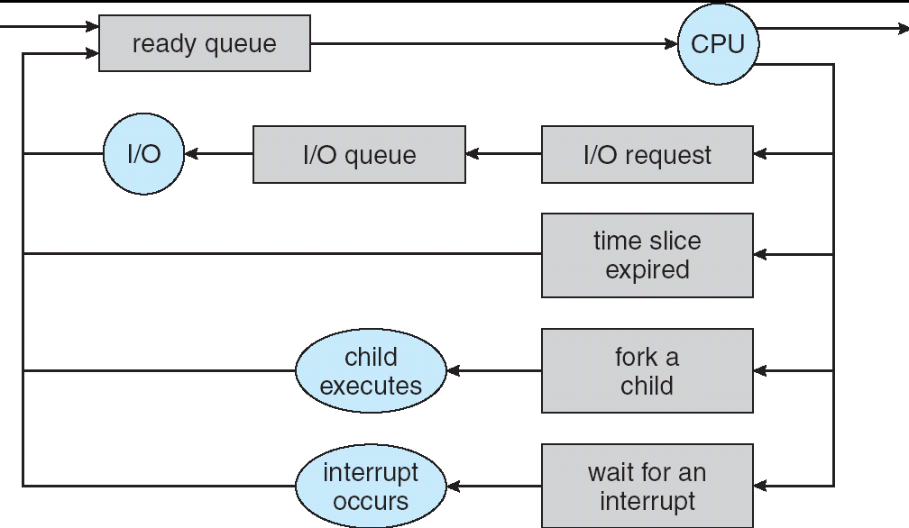
Recall: CPU Scheduling
Earlier, we talked about the life-cycle of a thread
Active threads work their way from Ready queue to Running to various waiting queues.

Slide 75
Recall: CPU Scheduling (Cont.)
Question: How does OS decide which thread to dequeue?
Obvious queue to worry about is ready queue
Others can be scheduled as well, however
Scheduling: deciding which threads are given access to resources from moment to moment

Slide 76
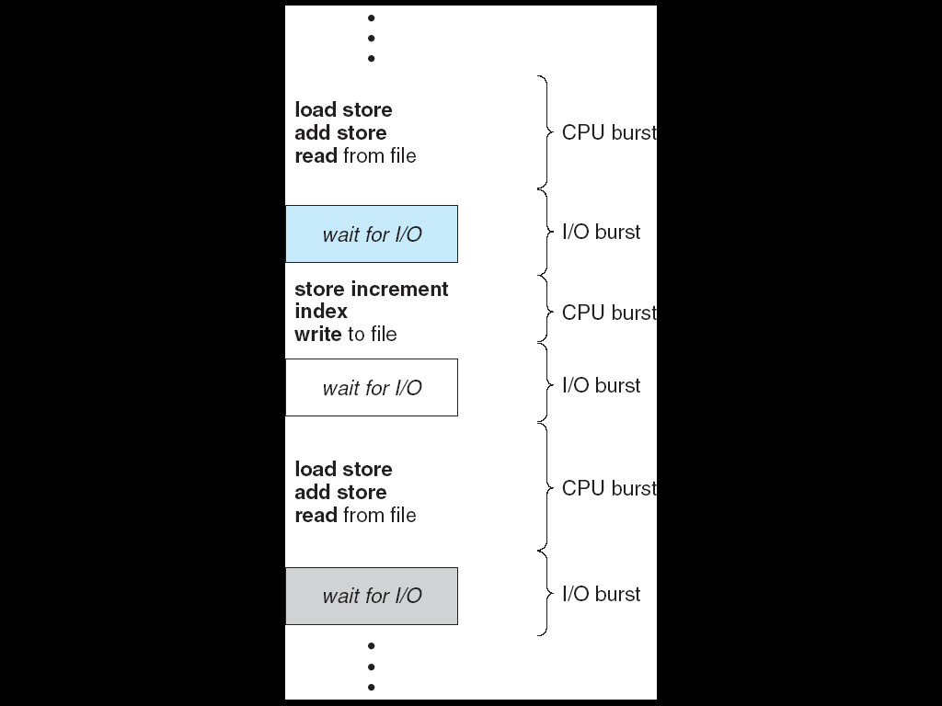
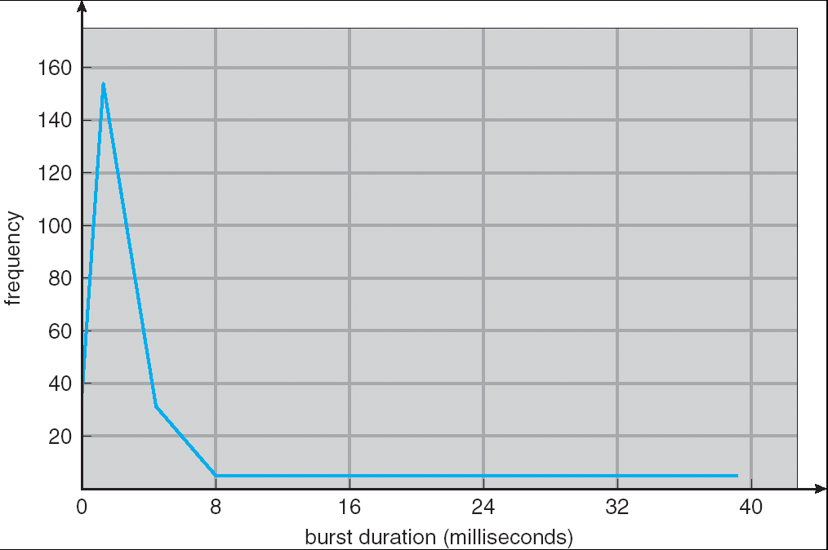
Assumption – CPU Bursts
Weighted toward small bursts
Execution model: programs alternate between bursts of CPU and I/O
Program typically uses the CPU for some period of time, then does I/O, then uses CPU again
Each scheduling decision is about which job to give to the CPU for use by its next CPU burst
With timeslicing, thread may be forced to give up CPU before finishing current CPU burst

Slide 77
Scheduling Assumptions
CPU scheduling big area of research in early 70’s
Many implicit assumptions for CPU scheduling:
One program per user
One thread per program
Programs are independent

Slide 78
Scheduling Assumptions (Cont.)
Clearly, unrealistic but they simplify the problem
For instance: is “fair” about fairness among users or programs?
If I run one compilation job and you run five, you get five times as much CPU on many operating systems
The high-level goal: Dole out CPU time to optimize some desired parameters of system
USER1
USER2
USER3
USER1
USER2
Time

Slide 79
Scheduling Policy Goals/Criteria
Minimize Response Time
Minimize elapsed time to do an operation (or job)
Response time is what the user sees:
Time to echo a keystroke in editor
Time to compile a program
Real-time tasks: Must meet deadlines imposed by World
Notes:
What does CPU scheduling have to do with efficient use of the disk?
A lot! Have to have the CPU to make a disk request
Fairness: Minimize # of angry phone calls? Minimize my response time?

Slide 80
Scheduling Policy Goals/Criteria (Cont.)
Maximize Throughput
Maximize operations (or jobs) per second
Throughput related to response time, but not identical:
Minimizing response time will lead to more context switching than if you only maximized throughput
Two parts to maximizing throughput
Minimize overhead (for example, context-switching)
Efficient use of resources (CPU, disk, memory, etc)
Notes:
What does CPU scheduling have to do with efficient use of the disk?
A lot! Have to have the CPU to make a disk request
Fairness: Minimize # of angry phone calls? Minimize my response time?

Slide 81
Scheduling Policy Goals/Criteria (Cont.)
Fairness
Share CPU among users in some equitable way
Fairness is not minimizing average response time:
Better average response time by making system less fair
Notes:
What does CPU scheduling have to do with efficient use of the disk?
A lot! Have to have the CPU to make a disk request
Fairness: Minimize # of angry phone calls? Minimize my response time?

Slide 82
First-Come, First-Served (FCFS) Scheduling
First-Come, First-Served (FCFS)
Also “First In, First Out” (FIFO) or “Run until done”
In early systems, FCFS meant one program scheduled until done (including I/O)
Now, means keep CPU until thread blocks
Example: Process Burst Time P₁ 24 P₂ 3 P₃ 3
Suppose processes arrive in the order: P₁ , P₂ , P₃ The Gantt Chart for the schedule is:
P₁
P₂
P₃
0
24
27
30

Slide 83
FCFS Scheduling (Cont.)
Example continued:
Waiting time for P₁ = 0; P₂ = 24; P₃ = 27
Average waiting time: (0 + 24 + 27)/3 = 17
Average Completion time: (24 + 27 + 30)/3 = 27
Convoy effect: short process behind long process
P₁
P₂
P₃
0
24
27
30

Slide 84
FCFS Scheduling (Cont.)
Example continued:
Suppose that processes arrive in order: P₂ , P₃ , P₁ Now, we have:
Waiting time for P₁ = 6; P₂ = 0; P₃ = 3
Average waiting time: (6 + 0 + 3)/3 = 3
Average Completion time: (3 + 6 + 30)/3 = 13
In second case:
Average waiting time is much better (before it was 17)
Average completion time is better (before it was 27)
FIFO Pros and Cons:
Simple (+)
Short jobs get stuck behind long ones (-)
Safeway: Getting milk, always stuck behind cart full of small items
P₂
P₃
P₁
0
3
6
30

Slide 85
Round Robin (RR) Scheduling
FCFS Scheme: Potentially bad for short jobs!
Depends on submit order
If you are first in line at supermarket with milk, you don’t care who is behind you, on the other hand…
Round Robin Scheme
Each process gets a small unit of CPU time (time quantum), usually 10-100 milliseconds
After quantum expires, the process is preempted and added to the end of the ready queue.
n processes in ready queue and time quantum is q ⇒
Each process gets 1/n of the CPU time
In chunks of at most q time units
No process waits more than (n-1)q time units

Slide 86
RR Scheduling (Cont.)
Performance
q large ⇒ FCFS
q small ⇒ Interleaved (really small ⇒ hyperthreading?)
q must be large with respect to context switch, otherwise overhead is too high (all overhead)

Slide 87
Example of RR with Time Quantum = 20
Example: Process Burst Time P₁ 53 P₂ 8 P₃ 68 P₄ 24
The Gantt chart is:
Waiting time for P₁=(68-20)+(112-88)=72 P₂=(20-0)=20 P₃=(28-0)+(88-48)+(125-108)=85 P₄=(48-0)+(108-68)=88
Average waiting time = (72+20+85+88)/4=66¼
Average completion time = (125+28+153+112)/4 = 104½
Thus, Round-Robin Pros and Cons:
Better for short jobs, Fair (+)
Context-switching time adds up for long jobs (-)
P₁
P₂
P₃
P₄
P₁
P₃
P₄
P₁
P₃
P₃
0
20
28
48
68
88
108
112
125
145
153

Slide 88
Round-Robin Discussion
How do you choose time slice?
What if too big?
Response time suffers
What if infinite (∞)?
Get back FIFO
What if time slice too small?
Throughput suffers!
Actual choices of timeslice:
Initially, UNIX timeslice one second:
Worked ok when UNIX was used by one or two people.
What if three compilations going on? 3 seconds to echo each keystroke!
Need to balance short-job performance and long-job throughput:
Typical time slice today is between 10ms – 100ms
Typical context-switching overhead is 0.1ms – 1ms
Roughly 1% overhead due to context-switching

Slide 89
Comparisons between FCFS and Round Robin
Assuming zero-cost context-switching time, is RR always better than FCFS?
Simple example: 10 jobs, each take 100s of CPU time RR scheduler quantum of 1s All jobs start at the same time
Completion Times:
Both RR and FCFS finish at the same time
Average response time is much worse under RR!
Bad when all jobs same length
Also: Cache state must be shared between all jobs with RR but can be devoted to each job with FIFO
Total time for RR longer even for zero-cost switch!
Job # | FIFO | RR
1 | 100 | 991
2 | 200 | 992
… | … | …
9 | 900 | 999
10 | 1000 | 1000

Slide 90
Earlier Example with Different Time Quantum
P₂
[8]
P₄
[24]
P₁
[53]
P₃
[68]
Best FCFS:
0
8
32
85
153
Quantum
P₁
P₂
P₃
P₄
Average
Wait
Time
Best FCFS
32
0
85
8
31¼
Q = 1
84
22
85
57
62
Q = 5
82
20
85
58
61¼
Q = 8
80
8
85
56
57¼
Q = 10
82
10
85
68
61¼
Q = 20
72
20
85
88
66¼
Worst FCFS
68
145
0
121
83½
Completion
Time
Best FCFS
85
8
153
32
69½
Q = 1
137
30
153
81
100½
Q = 5
135
28
153
82
99½
Q = 8
133
16
153
80
95½
Q = 10
135
18
153
92
99½
Q = 20
125
28
153
112
104½
Worst FCFS
121
153
68
145
121¾

Slide 91
Synchronization Summary
Monitors: A lock plus zero or more condition variables
Always acquire lock before accessing shared data
Use condition variables to wait inside critical section
Three Operations: Wait(), Signal(), Broadcast()
Round-Robin Scheduling:
Give each thread a small amount of CPU time when it executes; cycle between all ready threads
Pros: Better for short jobs

